Slide 1
Cyclistic Bike-share
PRESENTED BY: PIUS MUTUMA KIMATHI.
LAST UPDATED: March 3rd, 2021

Slide 2
Table of Contents
Purpose Statement
The Story
Conclusion
Appendix

Slide 3
Objective
Analyse how annual members and casual riders use Cyclistic bikes differently

Slide 4
Summary
In 2016, Cyclistic launched a successful bike-share offering. The bikes can be unlocked from one station and returned to any other station in the system anytime.
Customers who purchase single-ride or full-day passes are referred to as Casual Riders. Customers who purchase annual memberships are Cyclistic member

Slide 5
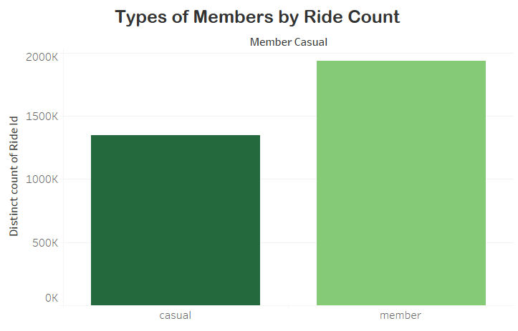
Key Findings: The Types of Members by Ride Count
The total number of rides is higher in annual members than the casual riders.
The annual members had a total ride count by ride ID of 1,935,525.
The casual riders had a total ride count by ride ID of 1,347,838.

Slide 6
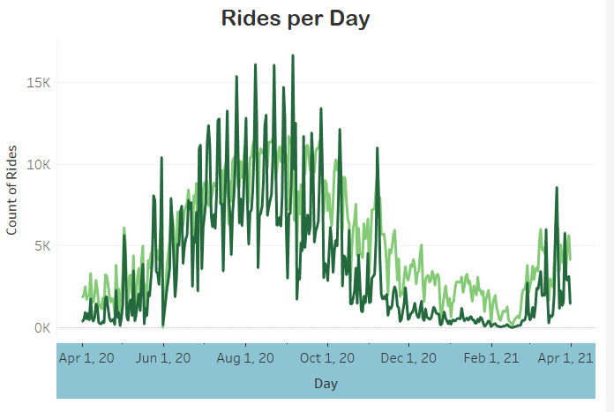
Key Findings: Count of Rides per Day
The total rides per day is higher in annual members than the casual riders.
The highest count of daily rides was on September 5, 2020 at 16,654 rides by casual riders.
The lowest was on May 31, 2020 at 15 rides by annual members.

Slide 7
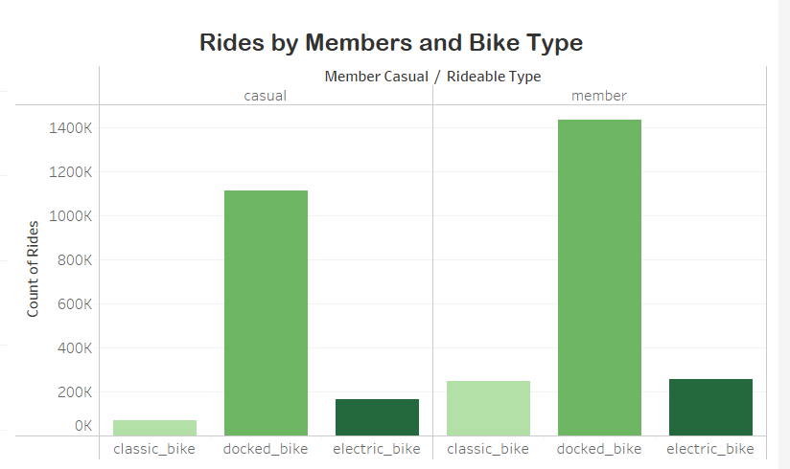
Key Findings: Total Rides by Members and the Bike Type
The annual members preferred to use the docked bike with the least used type of bike being the classic bike.
The casual members used the docked bike more than the electric and classic bike. The least used bike type was the classic bike.
Docked bike types are locked bikes which are released by computer control. The bike can be unlocked by paying for it.

Slide 8
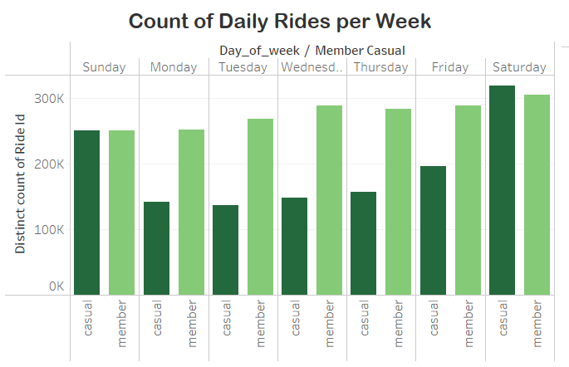
Key Finding: Average Weekly Rides per Day
The casual riders had most rides on Saturdays with the total rides on Sundays being slightly higher in annual members.
The casual riders had low rides on other days of the week and were higher during weekends.

Slide 9
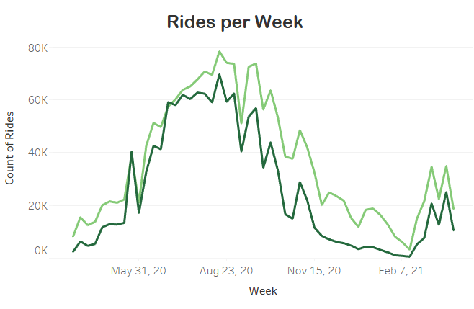
Key Finding: Weekly Rides
The annual members had more weekly rides with the rides peaking on the week of August 16, 2020 at 78,283 rides.
The casual riders had their highest weekly ride on the week of August 16, 2020 at 69,607 rides.
The lowest weekly rides was on February 14, 2021 at 560 rides in casual riders. The annual members had their lowest weekly rides on the same week at 3260 rides.

Slide 10
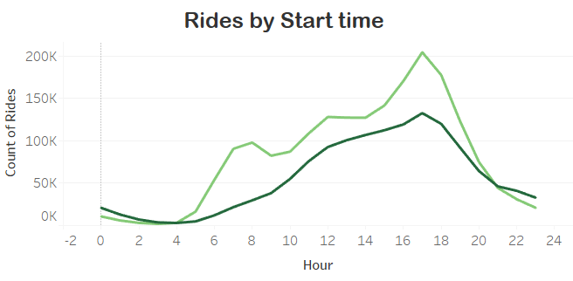
Key Finding: Start time of the Rides
The highest number of rides by start time was at 5 PM in both annual members and casual riders.
The lowest start time of rides was at midnight where no rides occurred in both annual members and casual riders.

Slide 11
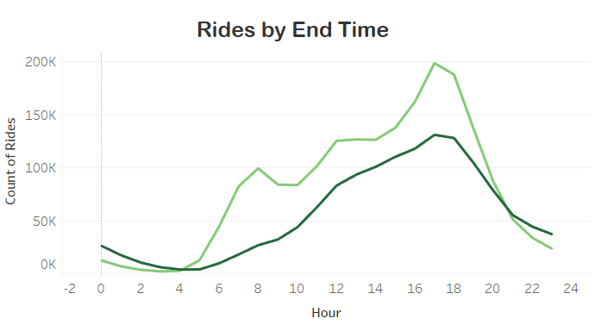
Key Finding: End Time of the Rides
The highest number of rides by end time was at 5 PM in both annual members and casual riders.
The lowest end time of rides was at midnight where no rides occurred in both annual members and casual riders.

Slide 12
Conclusion
The highest number of rides occurred during the Summer in August in both types of riders.
The lowest number of rides occurred during the Winter in February.
Both riders had their daily rides in the evening hours.
The Casual riders had more rides on Saturday and Sunday which was more than the Annual members.
Both riders preferred to use the docked type of bike.

Slide 13
Recommendations
Marketing memberships to casual riders could begin on weekends from 4 PM to 6 PM at most popular locations for casual riders.
Membership to casual riders could be promoted with weekend-only memberships as their number of rides surge on weekends.
Data about user demographics, and the goal of cycling could help improve the analysis.
Data about the choice of the membership in casual riders could help develop ways to make necessary changes.

